Slide 1
Introduction to PowerShell
Neil Iversen

Slide 2
Points of Interest
Introduction
Getting Around
Basic Syntax
Making yourself at ~
Not-So-Basic Syntax
Questions

Slide 3
Introduction
Developer at Inetium
http://justaddcode.com/blog/
  Really late breaking news
I am not an Administrator

Slide 4
What is PowerShell?
Different things to different people
It’s a
  Shell
  Cool .bat file
  VBScript replacement
  Admin’s Best Friend
  Developer’s Best Friend
  …

Slide 5
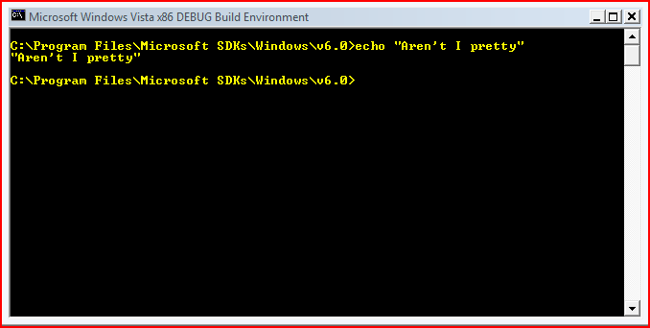
cmd.exe

Slide 6
+

Slide 7
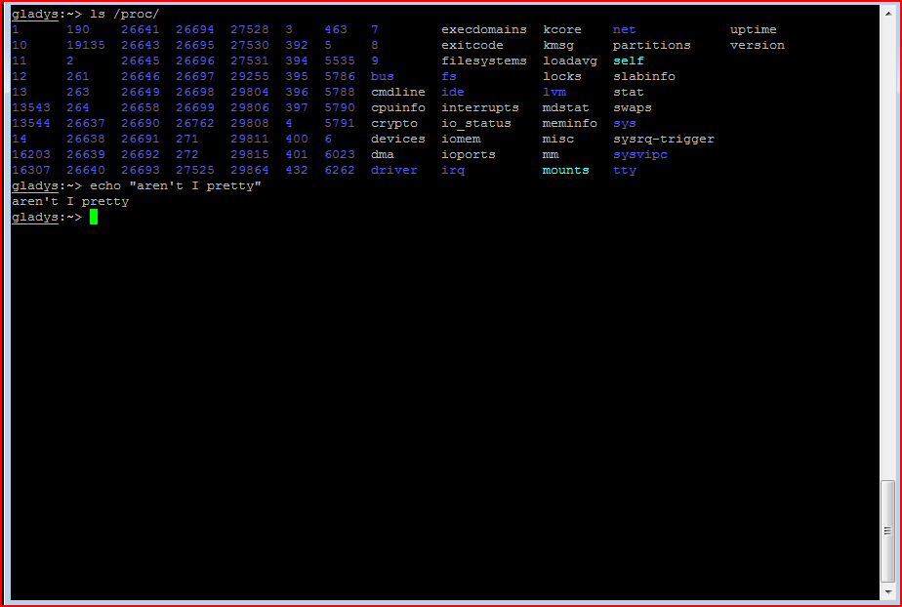
unix cmdline

Slide 8
+

Slide 9

.net

Slide 10
=

Slide 11
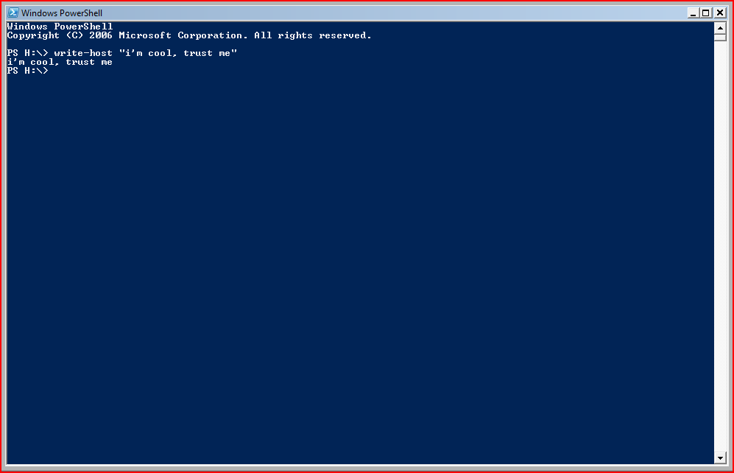
An ugly, but powerful shell

Slide 12
Getting Around
dir
cd
del
Mkdir
help
ls
cd
rm
mkdir
man

Slide 13
Core Components
Alias
  cd = set-location
  Dir = get-childitem
Cmdlet
  Workhorse of PowerShell
Function
  Block of script
Provider
  Adds alternate ‘directory structure’
  Think ‘/proc’ only niftier
  Get-PSdrive
Snapin
  Group of PowerShell functionality

Slide 14
PS> Lets see that shell

Slide 15
PoSH Basics
Verb-noun: write-host, where-object,get-content
Help is your friend
  help write-host
  help write-host –detailed
  Help *write*
$variable
  Scopes: global, script,local
{} scriptblocks

Slide 16
PoSH Basics - Variables
$foo = “bar”
$anArray = 1,2,3,4
[int]$someInt = 5
[xml]$xmlDoc = “<a><b>stuff</b></a>”
[MyClass.MyType]$someThing

Slide 17
PS> Lets see that shell

Slide 18
Conditions and Flow Control
Some Operators
  -eq
  -lt / -gt
  -le / -ge
  -like / -notlike
  -match / -imatch
Control
  If
  switch
help about_comparison_operators

Slide 19
More PoSH Basics: Pipeline
Everything is a System.Object
  Unless its something more useful
dir | where-object {$_.Length –gt 5} | select-object –last 2 | sort-object -prop Extension –desc
$anArray | sort

Slide 20
The Most Useful Commands
Foreach-object
  dir | foreach-object { $_.Name }
  Alias: dir | % { $_.Name }
Where-object
  dir | where-object {$_.Length –gt 10}
  Alias: dir | ? {$_.Length –gt 10}
Select-object
  dir | select-object –first 5
  Alias: none
Honorable Mentions: Sort-Object, Group-Object

Slide 21
PS> Lets see that shell

Slide 22
Dealing with Output
Formatting
Output
Format-Custom
Format-List
Format-Table
Format-Wide
Out-Default
Out-Null
Out-Host
Out-Printer
Out-String

Slide 23
PS> Lets see that shell

Slide 24
Making yourself at ~
Microsoft.PowerShell_profile.ps1
  .bashrc
  .tcshrc
  .whatEverKSHuses
Be lazy, $profile tells you where to go
  PS> notepad $profile
Common Uses
  Custom prompt()
  Load custom variables and scripts
  Snapins
  Make it Less Ugly

Slide 25
PS> Lets see that shell

Slide 26
Not-So-Basic Syntax
Loading .NET Assemblies
  [System.Reflection.Assemby]::LoadFrom(‘some.dll’)
Get-Member – Describes functions and properties on an object
New-object – creates a new object
  COM or .NET object
  Calls the constructor
  $someObject = new-object System.ArrayList

Slide 27
Pseudo-Reflection
Get-Member
  List out Methods, Properties and their arguments
Add-Member – Adds a Property or Method
  dir | add-member -passthru -membertype scriptmethod -name Something {write-host "Some file: "$this.Name} | %{$_.Something()}
ps1XML Files – Extend Object Types
  Example: ConvertToBase64 on Files

Slide 28
PS> Lets see that shell

Slide 29
LINQ and PowerShell
LINQ
PowerShell
int[] numbers = { 5, 4, 1, 3, 9, 8, 6, 7, 2, 0 };
var lowNums =
from n in numbers
where n < 5
select n;
Console.WriteLine("Numbers < 5:");
foreach (var x in lowNums) {
Console.WriteLine(x);
}
$numbers = 5, 4, 1, 3, 9, 8, 6, 7, 2, 0
Write-host “Numbers < 5:”
$numbers | ?{$_ -lt 5}

Slide 30
Other Practical Uses
Exchange 2007
  The Admin UI calls PowerShell
Active Directory Manipulation
  New-Object DirectoryServices.DirectoryEntry "LDAP://cn=kenmyer, ou=Finance, dc=fabrikam, dc=com" | Select-Object name, telephoneNumber
Full suite of WMI calls

Slide 31
Useful Projects
PowerShell Analyzer – http://www.powershellanalyzer.com/
PowerTab -http://thepowershellguy.com/blogs/posh/archive/tags/PowerTab/default.aspx
Console.exe - http://sourceforge.net/projects/console/
PowerShell Community Extensions - http://www.codeplex.com/PowerShellCX/
PowerShell Remoting - http://www.codeplex.com/powershellremoting

Slide 32
Diversions
WPF in PoSH
Space Invaders
Text to Speech

Slide 33
Questions?

Slide 34
Giveaway
2 Copies of PowerShell Analyzer – Final Version
Using PowerShell of Course!
(gc names.txt)[(get-random -min 0 -max ((gc names.txt).Length-1))]
OR
(Get-Date).AddDays((get-random -min 1 -max 365))

Slide 35
Thanks!

