Slide 1
Minneapolis Office Developer Interest Group (MODIG)
December 10, 2009
Client Object Model Development
Neil Iversen
http://sharepointmn.com/modig

Slide 2
The Plan
Introduction ← You are here
SharePoint 2010 Developer Overview

Slide 3
User Group Goals
Provide a community for SharePoint Developers
Share development knowledge
Exchange tips/tricks/other/free pizza

Slide 4
User Group Format
Presentations
Presentations are good
Demos are better
QA/Discussion/Random Things

Slide 5
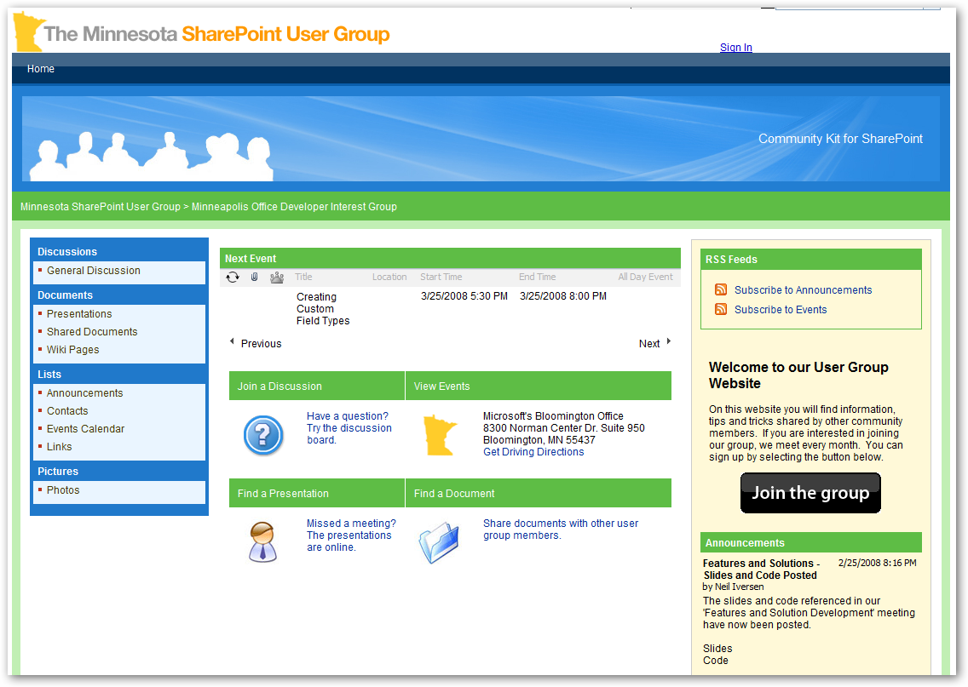
Sharepointmn.com/modig/
Our current home
Meeting information
Usually has the right time
Previous presentations
Running on SharePoint
As required by SharePoint User Group Law

Slide 6
Upcoming
Next Meeting
Jan 26, 2010
Topic: TBD
Location: Where you are
MNSPUG
Jan 12 (9:00am – Noon)
Topic : Composite Applications in SharePoint 2010

Slide 7
Events of Note
SharePoint 2010 in Wider Availability
SharePoint 2010 Developer Center
http://msdn.microsoft.com/en-us/sharepoint/ee514561.aspx

Slide 8
What is the Client Object Model
Working with the COM
.NET
Silverlight
Javascript
Questions

Slide 9
What’s a Client Object Model?
Run code against SharePoint…only remotely
Its like a Web Service call, only prettier
Why use it?
‘No Code’ solutions
Fancy AJAX
Rich Internet Applications (RIA)
Integrate with WinForm/WPF Apps
(Potentially) Get around Solution Limits

Slide 10
So, how’s it work?
You use its DLL
It bundles your calls
It calls a webservice
You get pretty objects back

Slide 11
Client Object Model Runs on Remote Machine
Simple API to Add, Retrieve, Update and Manage Data in SharePoint
Commands batched for Performance
SharePoint Data
Consistent
Efficient
Client Application
.NET CLR
Silverlight CLR
JavaScript

Slide 12
Getting Started – Where Am I?
ClientContext
Sets up the Environment your calls will be in
The Web you’ll be working with
Web and SilverLight have a Current context
.NET Requires you to specify a location
AuthenticationMode
Uses currently logged in User by default
Set to FormsAuth
Example:
clientContext = new ClientContext(txtUrl.Text);
web = clientContext.Web;

Slide 13
Retrieving Items
Item Collections can be retrieved by ‘calling’ them
web.Lists
LINQ is available for some objects
var query = from l in web.Lists where l.Title = “Tasks”
CAML is preferred for ListItems
CamlQuery object

Slide 14
Nothing Happened!
Everything is async
Nothing happens until you clientContext.ExecuteQuery
But first you need to tell it the objects to Load
clientContext.Load(lists)

Slide 15
Why can’t I see all my fields?
SharePoint is trying to conserve resources
It only brings back what it has to
Use Load to override this behavior
Load(myLists, lists=>lists.Include(list =>list.Title,list=>list.Author)
Or
Load(myLists, “Include(Title,Author)”)

Slide 16
Demo - .NET Client Object Model

Slide 17
Adding a new Item
ListItemCreationInformation
Sets the context for the Add
collection.Add(listItemCreationInformation)
Returns Item
Ex: ListItem item = list.Add(lici)
Then
item.Update()
clientContext.ExecuteQuery()

Slide 18
Updating an Item
Item.Update!
clientContext.ExecuteQuery()

Slide 19
Deleteing an Item
Item.DeleteObject
clientContext.ExecuteQuery()

Slide 20
Demo - .NET CRUD

Slide 21
ECMAScript Object Model
Commonly called ‘javascript’ by humans
Requires:
MSIE 7+
Firefox 3.5+
Safari 4.0+
Needs SP.js to be loaded
<SharePoint:ScriptLink runat="server" Name="sp.js" Localizable="false" LoadAfterUI="true" />
Stored in /LAYOUTS
SP.js – SP.debug.js

Slide 22
Demo – Javascript Demo

Slide 23
SilverLight
Probably the funnest of the options
Give you rich visualization options
Has Client Object Model like JS/.NET

Slide 24
Demo – SilverLight Demo

Slide 25
Questions?

Slide 26
Next Meeting
Topic / Time Selection
Client Model – Deeper Dive
Web Part Development
PowerShell
BCS

Slide 27
Random Stuff
Feedback Forms
Mingle, Eat, Feedback
See you next time!
Neil Iversen
Inetium
http://justaddcode.com

