Slide 1
PowerShell for Developers
Neil Iversen
Inetium
http://justaddcode.com/blog

Slide 2
Introduction
Developer at Inetium
http://justaddcode.com/blog/
  Watch out for the tumbleweeds
Vocal PowerShell Enthusiast

Slide 3
The Plan
Introduction to PowerShell
I sell you on PowerShell
You sell PowerShell

Slide 4
What’s this PowerShell Nonsense?

Slide 5
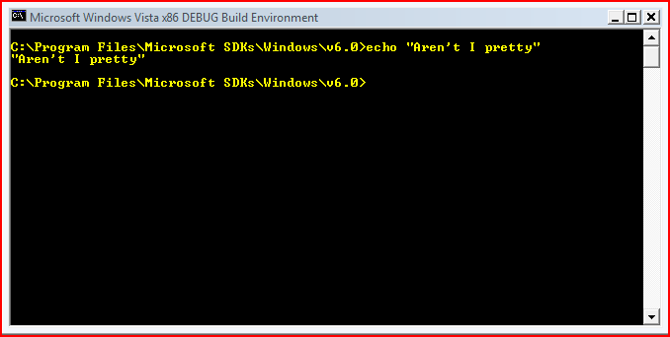
cmd.exe

Slide 6
+

Slide 7
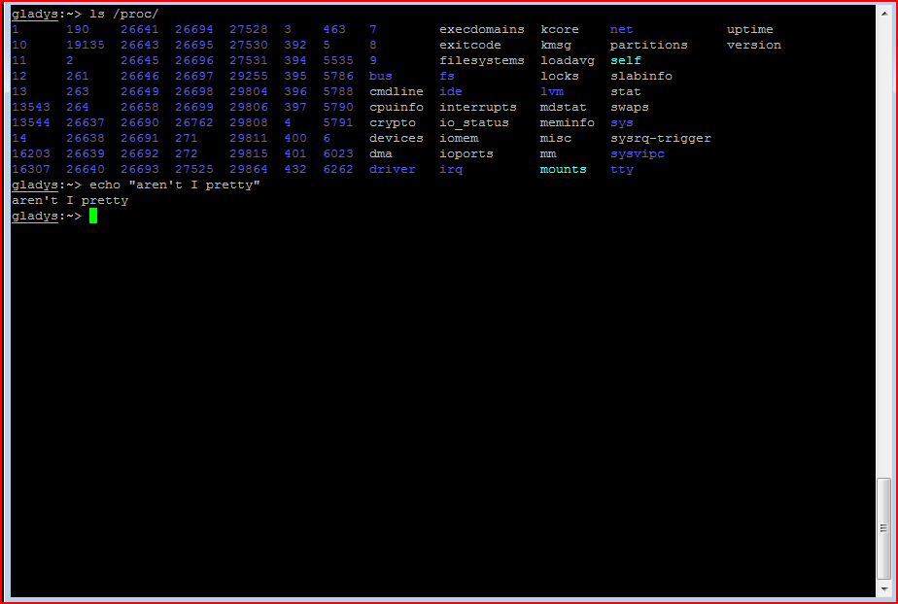
unix cmdline

Slide 8
+

Slide 9

.net

Slide 10
=

Slide 11
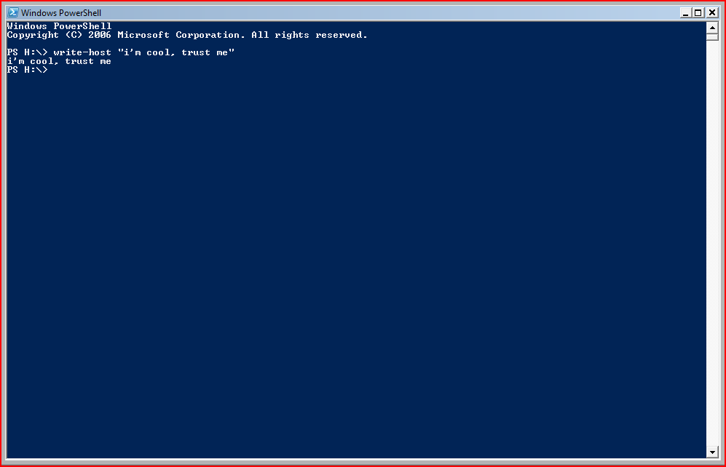
An ugly, but powerful shell

Slide 12
Great, cmd.exe was fine for me
Talk to MS Marketing
  Initially promoted as a fancy shell
  Currently primarily marketed to Administrators
  Starting to gain traction among the developer set
    (that’s you)

Slide 13
Why do I care?
It’s a good shell
You can do dev in it
You can do dev for it
Reduce time spent testing
Reduce time spent debugging

Slide 14
Very Scientific Language Usefulness Continuum (Patent Pending)
SysAdmin Printer Drivers
C++
.NET (C#/VB.NET)
Scripting Languages (Ruby, Python)
BASH, SH
PowerShell

Slide 15
Developing Faster
Traditional SharePoint Development
  Time wasted during Testing
PowerShell / .NET Hybrid Development
  ‘Risky’ development done in PoSH
  Code converted to .NET (C#/VB)
  Shorter Deploy/Test Cycle
Code
Compile
Deploy
Test
Code
Compile
Deploy
Prototype (PoSH)
Code
Compile
Deploy
Test

Slide 16
PowerShell as a Shell

Slide 17
PowerShell as a Shell
Getting Around
dir
cd
del
Mkdir
help
ls
cd
rm
mkdir
man

Slide 18
PowerShell as a Shell
Core Components
Alias
  cd = set-location
  Dir = get-childitem
Cmdlet
  Workhorse of PowerShell

Slide 19
PoSH Basics
Verb-noun: write-host, where-object,get-content
Help is your friend
  help write-host
  help write-host –detailed
  Help *write*

Slide 20
PS> Lets see that shell
Notes:
ls
Ps
Cd

Slide 21
PowerShell as a Scripting Language
Luckily PowerShell is more than a cmd.exe replacement
Loosely typed variables
  $foo = “bar” (implicit string)
  $ary = 1,2,3,4 (object array)
Strongly typed variables
  [string]$foo = “bar”
Enhanced Types
  [xml]$d = “<a><b><c>c stuff 1</c><c>c stuff 2</c></b></a>”
  $d.a.b.c (array of strings)

Slide 22
PowerShell as a Scripting Language
Providers
  Emulate a ‘drive’ navigation structure
  Extensible
  Examples
    Registry
    Active Directory
    SharePoint

Slide 23
Conditions and Flow Control
Some Operators
  -eq
  -lt / -gt
  -le / -ge
  -like / -notlike
  -match / -imatch
Control
  If
  switch
help about_comparison_operators

Slide 24
The Pipeline
First some background:
  In DOS/Unix
    Dir | more
      Run a directory and ‘pipe’ the output to the More command
      Actually passes the resulting text to the next command
      Unix has advanced text manipulation functions to parse
  In PowerShell
    Dir | more
      Passes the .NET Objects between commands
      System.IO.FileInfo in this case

Slide 25
The Pipeline
The most unique feature of PowerShell
Since everything in PowerShell is a .NET type, it can be passed as an argument
Enables a LINQ-esque experience
C#:
  foo = Class.Method();
  Bar = OtherClass.Method(foo);
  Baz = OtherOtherClass.Method(bar)
PowerShell:
  Class.Method() | OtherClass.Method() | OtherOtherClass.Method()

Slide 26
Common Pipeline Commands
Foreach-object
  dir | foreach-object { $_.Name }
  Alias: dir | % { $_.Name }
Where-object
  dir | where-object {$_.Length –gt 10}
  Alias: dir | ? {$_.Length –gt 10}
Select-object
  dir | select-object –first 5
  Alias: none
Honorable Mentions: Sort-Object, Group-Object

Slide 27
Dealing with Output
Formatting
Output
Format-Custom
Format-List
Format-Table
Format-Wide
Out-Default
Out-Null
Out-Host
Out-Printer
Out-String

Slide 28
Making yourself at ~
Microsoft.PowerShell_profile.ps1
  .bashrc
  .tcshrc
  .whatEverKSHuses
Be lazy, $profile tells you where to go
  PS> notepad $profile
Common Uses
  Custom prompt()
  Load custom variables and scripts
  Snapins
  Make it Less Ugly

Slide 29
PS> Lets see that scripting language

Slide 30
PowerShell as a Programming Language
Everything in PowerShell is a .NET type
  $foo = “bar” (System.String)
  $ary = 1,2,3,4 (System.Object[])
Using this knowledge we can call anything we’d use in C# or VB.NET
Couple Language Things
  [System.Drawing.Color]::Blue – Enum
  [System.Reflection.Assembly]::Load() - Static Method

Slide 31
PowerShell as a Programming Language
Loading .NET Assemblies
  [System.Reflection.Assemby]::LoadFrom(‘some.dll’)
Get-Member – Describes functions and properties on an object
New-object – creates a new object
  COM or .NET object
  Calls the constructor
  $someObject = new-object System.ArrayList

Slide 32
PowerShell as a Programming Language
PowerShell has build in Reflection
Get-Member
  Returns all the Properties and Methods for an object
  Ex: ls | get-member
Provides a good interface to explore objects

Slide 33
PowerShell as a Programming Language
Updating Types
Similar to Extension Types
Add-Member
  Add new Methods/Properties to an instance
Use ps1xml file to make changes semi-permanent and always applied for a specific .NET type

Slide 34
PS> Lets see that programming language

Slide 35
Interesting PowerShell Bits
Reading/Parsing
  Native CSV,XML read/write
Serialization
  Import-CLIXML, Export-CLIXML
  Save off .NET objects and then rehydrate them

Slide 36
Advanced V2 Features
Threading
  Start-PSJob
  Stop-PSJob
  Wait-PSJob
  Receive-PSJob
Remoting
  Enables Remote PowerShell calls to be performed
  Implemented using the Threading commands
Combine the two, and you have a pretty compelling option for distributing load.

Slide 37
Enhancing the Experience
The default shell is ugly
  Setup your $profile
  Get Intellisense
    Customizations allow inline intellisense
  Community kit
    Lots of good discussion and controls
  3rd Party Shells
    Host PowerShell in a different UI
      PowerShell Plus
      PowerShell Analyzer
      PoshConsole

Slide 38
PS> Lets see some extensible examples

Slide 39
Extensibility Points
Ps1xml
Cmdlets
Script cmdlets (v2)
Snapins
Modules (v2)

Slide 40
Creating a Cmdlet
Compiled and Portable
Bundled together in a Snapin
Inherit from CmdLet
WriteObject()
  Sends data back to the Pipeline
[Cmdlet(VerbsCommon.Get, “CmdletName“]
Script Only CmdLets in V2

Slide 41
Hosting PowerShell
Two Levels of Difficulty
  Execute Commands
  Host the UI

Slide 42
Hosting PowerShell
Execute Commands
  The easiest option
RunspaceInvoke.Invoke(“dir”)
Returns PSObject(s)

Slide 43
Hosting PowerShell
Host the UI
  Very difficult
Can provide immense amounts of power
Examples:
  PowerShellPlus
  PoshConsole

Slide 44
PS> Lets see it all together

Slide 45
Reducing Testing/Debugging Time
Eliminate Arguments
  It works on my pc
  Its impossible to know what that server is thinking
Delve Deeper
  See the running state as a problem occurs
  No need to redeploy code to test theories
  PSUnit for Unit Testing

Slide 46
Other Interesting Uses
PowerShell ASP
PowerShell as an Extensibility Methog
PowerBoots
PowerShell as a DSL

Slide 47
PS> Lets see something…different

Slide 48
References
PoshCode – http://www.poshcode.org/
PowerTab -http://thepowershellguy.com/blogs/posh/archive/tags/PowerTab/default.aspx
PowerShell Community Extensions - http://www.codeplex.com/PowerShellCX/
PowerShell Plus -http://www.powershell.com/plus/
PoshConsole - http://www.codeplex.com/PoshConsole
PowerBoots – PowerBoots.codeplex.com
Huddled Masses (Jaykul) – huddledmasses.org

Slide 49
Questions?

Slide 50
Thanks!
Neil Iversen
Inetium
http://justaddcode.com/blog/

