Slide 1
Getting data into Silverlight on SharePoint
Neil Iversen
http://justaddcode.com/blog

Slide 2
The Plan
Silverlight is cool
Getting Data is Hard
The Options

Slide 3
Making the Case for Silverlight
Rich client side interactions
Very useful graphical libraries
Buzzword Compliant
You can play sweet games with it

Slide 4
The Silverlight Crash Course
Silverlight 1.0 – Boring
Silverlight 2.0
.NET in your browser
Subset of the .NET framework
Silverlight 3.0
More .NET in your Browser
More libraries

Slide 5
Silverlight Crash Course – Continued
XAML – Declarative markup language
WPF for the Web
Write some C#/VB for the code
Results in a .XAP
Load it up in your browser…and presto!

Slide 6
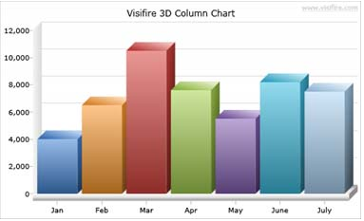
Making Silverlight Graphical
Using Visifire Today

Slide 7
DEMO: Making a Graph in Silverlight

Slide 8
Boring!
I want some data in there
Common Method
Web Service
We’re in SharePoint, lets look at that first

Slide 9
Connections in SharePoint
Use Part to Part communication to provide a value
Place it in Silverlight using InitParams
HTMLish way to pass params to Silverlight

Slide 10
DEMO: Passing SharePoint data to SL

Slide 11
External Data
Finally, the Web Service example!
Options
Web Client
WCF Service
RIA Services (Additional Addon)

Slide 12
DEMO: The Digg Example

Slide 13
Well that was easy
If only it was always like that!
Digg is special, it has a client policy xml file
Twitter doesn’t
Origin Policy
Limits you to calling things on the same server as YOUR XAP
Same Port and Everything
Silverlight respects Flash client policy files

Slide 14
Getting around Origin
Common Approaches
Proxy Web Service
Tunnel whatever request you want through a custom web service
Requires you to maintain another mapping layer
Hard to protect against rogue internet people
RIA Services
Very cool, lets you pass your domain objects around
Dynamically writes web service proxy code for you
Currently in Preview, not ‘Production’
Silverlight 3 Only
Trickery

Slide 15
Oooh, I like trickery
Toolbox
We’ve got a control that’s running that can hit web services and databases
Silverlight can execute javascript and has access to the web page
The Plan
Make our control do the dirty work and dump it into the DOM
Silverlight parses and interprets the results

Slide 16
DEMO: Trickery

