Slide 1
Effectively Using Features and Solutions
Neil Iversen
Inetium
http://justaddcode.com

Slide 2
The Plan
Solution/Feature Introduction
Change Control
Better Managing Features

Slide 3
Why are you working with these?
Why are you doing this?
  Repeatable Deployment
  Development Environment Sync
  Code/Content Promotion
  Governance
  You like a clean smelling server

Slide 4
Solution Basics
At its core, a solution pushes files around
  The File Bus of SharePoint
‘Farm Safe’ – Works across Front Ends and App Servers
Deployed to the Farm, not specific servers

Slide 5
What can I put in a Solution?
Assemblies
SafeControls
Code Access Security (CAS) Policies
Site Definitions
Resource Files

Slide 6
Solution
Assemblies
Site Definitions
Code Access Security
Features
Files
Resource Files
DWPs
Solutions are the package
Contain many different element, mostly files
Can contain multiple features
Site Definitions
Resource Files
Feature A
Feature B
Feature C

Slide 7
Solution Life Cycle – High Level
Develop
Deploy
Develop Update
Remove
Core functionality created
Made available on the SharePoint server
Additional changes made and solution is rebuilt
Removed from SharePoint
Deploy Update
Deploy updated Solution

Slide 8
Solution Anatomy
Manifest.xml
  Defines what is in the solution
Raw files
  Everything that the manifest.xml referred to
Solution.ddf
  Required for MakeCab to build WSP

Slide 9
A Note About Tools
Common Tools
  VSeWss
  WSPBuilder
  SPTemplateLand
Rolling your own
  I use PowerShell and VS Templates

Slide 10
Demo: Creating A Simple Solution

Slide 11
Features
Deployable unit of functionality
Used to customize SharePoint
Extensively used by SharePoint itself
Stored in the Hive
  12\TEMPLATE\FEATURES
  Each feature in its own directory

Slide 12





Scopes
Farm
Web App
Site
Web
Database
Indexer
WFE A
WFE B
Extranet WFE
http://sitecollection
http://external
http://sitecollection/deptA
http://external/clientA
http://sitecollection/deptB

Slide 13
Feature Lifecycle
Installed
Deactivated
Uninstalled
Activated

Slide 14
Relationship between Features and Solutions
Solutions are the shipping company
  Extremely effective at getting files placed on servers
  Farm Safe
  Can be sync’d if a WFE has been offline
  Can’t trigger events
Features are the shiny gadget in the box
  Provide the actual functionality
  Has an eventing lifecycle
  Non-Object model calls only affect local server
Notes:
Can features exist outside of solutions? Sure, but they aren’t farm safe then.

Slide 15
Anatomy of a Feature
Feature Directory
  Contains all the files for the feature
Feature.xml
  Main directives for the feature
  Can reference other XML files for directives
Xml Files
  More specific definitions of the feature
Other Files

Slide 16
Key Feature Types
Content Type
Custom Action
Delegate Controls
Events
Feature Stapling
Field
Lists (Templates and Instances)
Module
Workflow

Slide 17
Solution Life Cycle – Responsiblity
Developer
Develop
Build
Administrator
Add
Upgrade
Retract
Delete
Build
Develop

Slide 18
Developers: Be Nice to your Admins!
Admin’s Interest:
  What do I have to do to deploy this
  What will it break when I do deploy it?
  When it does break, then what?
  How can I tell which version this is?
Dev Interest:
  I want to go home
Notes:
You don’t always have dedicated SharePoint admins, so they might not know all the nuances of stsadm

Slide 19
Packaging for Success
Commands
  InstallSolution.ps1
  UpgradeSolution.ps1
  RemoveSolution.ps1
Documents
  README.txt
    How to Install
      When to execute commands
      Any Manual Steps
    How to Validate Install
    How to Uninstall
      When to execute commands
      Any Manual Steps
Notes:
Configure as much as makes sense for your environment. For example, you might have Install be a standard posh script that takes in the DeploymentUrl as an agrument

Slide 20

Oh you shouldn’t have!
Reduce communication issues
Fewer ‘it was in the email’ moments
Smoother deployments

Slide 21
How do Features/Solutions help with my Deployment Path
Key Issues
  Multiple developers on a project
  Multiple deployment environments
  Developers don’t have access to Production

Slide 22
Individual Developer Environments
  Developers build functionality into features/solutions
Developer Alice
Developer Bob
Developer Merge
Stage
Prod
Developer Charlie

Slide 23

Merge Environment
  Deployed as solutions to a merge environment
  Provide immediate feedback if something is broken
Developer Alice
Developer Bob
Developer Merge
Stage
Prod
Developer Charlie

Slide 24
Stage Environment
  Take approved solutions and promote them to Stage
  Solutions are already known to work
Developer Alice
Developer Bob
Developer Merge
Stage
Prod
Developer Charlie

Slide 25
Production Environment
  Move items from Stage
  Solutions can be deployed by administrators, without developers
Developer Alice
Developer Bob
Developer Merge
Stage
Prod
Developer Charlie

Slide 26
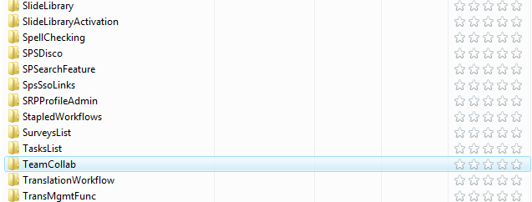
SharePoint’s Usage of Features
SharePoint extensively uses the Feature framework
MOSS ships with over 130 features
Great for learning by example

Slide 27
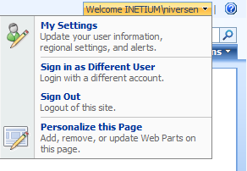
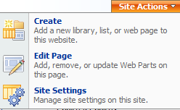
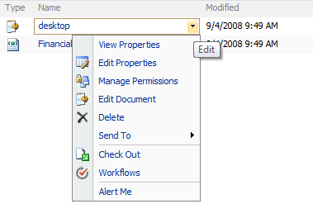
Custom Actions
Create your own menu options
Many extensibility points
Main Attributes
  Title
  Location
  GroupId
  Sequence
HideCustomAction
  Hides an existing Custom Action

Slide 28
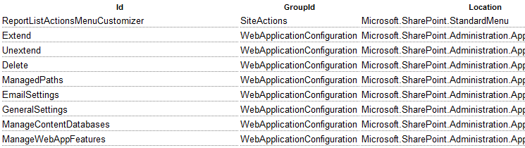
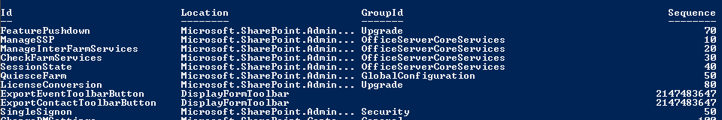
Where do I find those attributes?
Location, GroupID and Sequence seem pretty cryptic
John Holliday – Great Web Reference
Roll your own with PowerShell
Notes:
MSP-NIVERSEN C:\Users\niversen\Documents\Projects\DevConnections\DevConnections Fall 2008\Code\DevConnectionsFall2008\Ju
stAddCode.Deployment\Solutions\JustAddCode.PowerShellFeatures > $site.WebApplication.Farm.FeatureDefinitions | %{$_.GetE
lementDefinitions([System.Globalization.CultureInfo]::InvariantCulture)} | ? {$_.ElementType -eq "CustomAction"}|format-
table Id,Location,GroupId,Sequence

Slide 29
Custom Actions
URL Prefixes
  ~site – Relative link to the SPWeb
  ~sitecollection – Relative link to the SPSite
URL Replacements
  {ItemId} – List Item’s ID
  {ItemUrl} – List Item URL
  {ListId} – ID of the List
  {SiteUrl} – Like ~site except it can be used anywhere
Example
  <CustomAction
  Id="325b7c78-f041-4d1b-856b-f9b1e49ddfeb"
  GroupId="PersonalActions"
  Location="Microsoft.SharePoint.StandardMenu"
  Sequence="1000"
  Title=“My Title"
  Description=“A Custom Action
<UrlAction Url=“javascript:alert(‘You were at {SiteUrl}’);"/>
</CustomAction>

Slide 30
File Deployment Confusion
There must be 100 ways to deploy files!
Solutions:
  Features
  RootFile
  TemplateFile
  Specialized (Assembly,SiteDefs,Resource Files)
Features
  Modules
Notes:
RootFile element
Solution files can be copied to a specified folder directly under the \12 folder during deployment by inserting a RootFile element in the solution manifest file.
TemplateFile element
The TemplateFile element can be used to define the template files that must be deployed under the \12\Template folder. An example of the type of file you can deploy in this way is the fldtypes*.xml file, which defines the details of a custom field type. Use the Location attribute to specify the relative path to the file.

Slide 31
Modules
Deploy a file into a site
  Web
  Document Library
URL can be aliased
  MobileRedirect (\m) uses it
Can be marked ‘Ghostable’
Uninstall behavior is non-intuitive
Example:
  <Elements xmlns="http://schemas.microsoft.com/sharepoint/">
  <Module Name=“file" Url=“” Path=“”">
  <File Url=“MyFile.aspx" />
  </Module>
  </Elements>

Slide 32
Demo: Creating our First Feature

Slide 33
Stapling
Problem: Can’t customize out of the box Site Definitions
Solution: Stapling!
Scopes: Farm, Web App, Site
  Note: Not Web
FeatureSiteTemplateAssociation
  <FeatureSiteTemplateAssociation Id="b04e59b1-2c21-48fa-9497-470b1ab711b0" TemplateName="STS#0" />
  <FeatureSiteTemplateAssociation Id="fd45b13f-6334-4bce-b87c-49e3f820a74c" TemplateName=“GLOBAL#0" />

Slide 34
Site Template (STS#0)
My Stapled Feature
Stapled Features (FeatureSiteTemplateAssoc)
…
teamcollab
OOB Features
eventslist

Slide 35
Site Definitions vs Feature Stapling
Site Definitions
  Standard, supported model
  Updates can’t be applied to already created sites
  Doesn’t require a Developer
Feature Stapling
  The Feature Framework is supported, but yours probably aren’t
  Updates can be applied (reactivated) to already created sites, if the code supports it
  More flexible actions

Slide 36
Demo: Stapling in Action

Slide 37
Dependencies and Features
Your Feature might need to assume another feature is already active
Make several smaller features, then wrap them into a single feature that is dependant on them
Dependencies can only be one level deep
Example
  <ActivationDependencies>
  <ActivationDependency FeatureId="52890518-036f- 4027-babd-f4c7df3ee429" />
  <ActivationDependency FeatureId="6d276cfc-1c84- 46cc-8566-500e66213e06 " />
  </ActivationDependencies>

Slide 38
Feature Dependency
Dependant
Parent
 | Web | Site | App | Farm
Web
Site
App
Farm

Slide 39
Parent Feature
Child B
Child A

Slide 40
Hidden Feature
Hidden Feature
Child A

Slide 41
Hidden Feature – Activate Child
Hidden Feature
Child A
1.
2.

Slide 42
Hidden Feature - Deactivate
Hidden Feature
Child A
2.
1.

Slide 43
Hidden Feature - Deactivate
Hidden Feature
Child A
Child B
3.
1.
2.

Slide 44
Demo: Taking Advantage of Dependencies

Slide 45
Feature Receivers
Executes code when the state changes
Allows for extremely powerful code to get added
  While still being easily deployable
.NET Code
  Override
    FeatureInstalled, FeatureUninstalling
    FeatureActivated, FeatureDeactivating
Example
  <Feature Id="0a7e1ca9-ee71-4407-80a0-b5b57f4f6f5d"
  Title=“My Feature Receiver"
  Scope="Site"
  ReceiverAssembly=“MyAssembly, Version=1.0.0.0, Culture=neutral, PublicKeyToken=e35a4d2663eae0ae" ReceiverClass=“MyAssembly.MyFeatureReciever"
  xmlns="http://schemas.microsoft.com/sharepoint/">

Slide 46
Demo: Watching the Feature Lifecycle

Slide 47
Managing Site Lifecycles
Individual Sites are small applications
Have a lifespan longer than a Solution
Can progress in ‘phases’

Slide 48
Demo: Managing Long Living and Dynamic Sites

Slide 49
Summary
Develop with Features/Solutions
Allow for a standardized Change Process
Use Feature Capabilities Creatively

Slide 50
References
John Holliday’s Custom Action List

Slide 51
Your Feedback is Important
Please fill out a session evaluation form and either put them in the basket near the exit or drop them off at the conference registration desk.
Thank you!

Slide 52
Questions?

Slide 53
Thanks!
Neil Iversen
Inetium
http://justaddcode.com

